Slide 1

1151CS113-COMPUTER GRAPHICS AND IMAGE PROCESSING
SCHOOL OF COMPUTING
DEPARTMENT OF COMPUTER SCIENCE & ENGINEERING
UNIT-3

Slide 2
COMPUTER GRAPHICS AND IMAGE PROCESSING
Course Category: Program Core
Pre-requisite
Link to Other courses
Multimedia Systems
Computer Vision
SL.NO | Course Code | Course Name
1 | 1150MA103 | Engineering Mathematics 2
2 | 1150CS201 | Problem Solving using C

Slide 3
COMPUTER GRAPHICS AND IMAGE PROCESSING
Course Outcomes
CO Nos. | Course Outcomes | Level of learning domain (Based on revised Bloom’s taxonomy)
CO1 | Explain about basics of Computer Graphics | K2
CO2 | Summarize in the Shading models | K2
CO3 | Explain various Advance Modeling Techniques | K2
CO4 | Summarize in Basic of Image Processing | K2
CO5 | Explain various image restoration techniques | K3

Slide 4
COMPUTER GRAPHICS AND IMAGE PROCESSING
UNIT III ADVANCE MODELLING AND IMAGE PROCESSING
Procedural Models, Fractal Models, Grammar based models, particle systems. Image –Introduction, Elements of visual perception, Steps in Image Processing Systems – Image Acquisition – Sampling and Quantization – Pixel Relationships
REFERENCES
Hearn & Baker, “Computer Graphics C version”, 2nd ed. Pearson Education, 2012.
www.slideshare.net/.../computer-graphics-image-processing-lecture-n.

Slide 5
Computer Animation
Computer animation is a visual digital display technology that processes the moving images on screen.
In simple words, it can be put or defined as the art or power of giving life, energy and emotions etc. to any non-living or inanimate object via computers.
It can be presented in form of any video or movie. Computer animation has the ability to make any dead image alive.
The key/main concept behind computer animation is to play the defined images at a faster rate to fool the viewer so that the viewer should interpret those images as a continuous motion of images.

Slide 6
Animation Methods/Techniques
Frame by Frame (Traditional Method)
Procedural
Behavioral
Key Framing
Motion Capture
Dynamics

Slide 7
Procedural Models
The world around us is not made of perfect geometric objects. Clouds are not spheres. Mountains are not cones. A tree is not a cylinder. Yet Euclidean geometry describes only ideal shapes: spheres, circles, cubes, smoothly varying functions.
Fractal geometry is the geometry of the natural world, capable of describing complex and non-ideal objects.
In nature, and in complicated mathematical objects, there is often self-similarity, or the existence of small sub-objects that resemble the larger object.

Slide 8
Procedural Models
The key property of fractals is their self-similar nature. In other words, a fractal can be broken down into smaller objects which are themselves fractals.
Programming fractals is much easier with L-systems (please refer my Presentation Slides for introduction to L-systems).
The central concept of L-systems is that of rewriting. In general, rewriting is a technique for defining complex objects by successively replacing parts of a simple initial object using a set of rewriting rules or productions.

Slide 9

Procedural Models

Slide 10

Procedural Models

Slide 11

Procedural Models

Slide 12
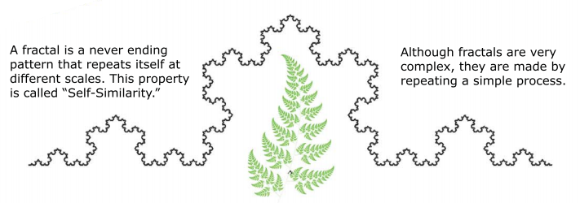
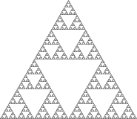
Fractals
Types of Fractals
Self Similar fractals
Self Affine fractals
Invariant fractals

Slide 13
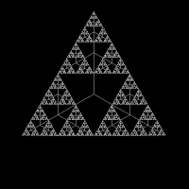
Fractals
Fractals are used in many areas such as
Astronomy − For analyzing galaxies, rings of Saturn, etc.
Biology/Chemistry − For depicting bacteria cultures, Chemical reactions, human anatomy, molecules, plants,
Others − For depicting clouds, coastline and borderlines, data compression, diffusion, economy, fractal art, fractal music, landscapes, special effect, etc.

Slide 14
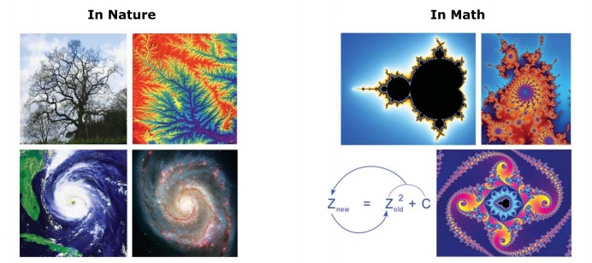
Where do we find Fractals?
Natural Fractals include branching patterns like trees, river networks, lighting bolts,
Blood vessels, etc and spiral patterns like seashells, hurricanes and galaxies
Mathematical Fractals , like the Mandelbrot set, are formed by calculating a simple equation thousands of times, feeding the answer back into the start. These fractals are infinitely complex , meaning we can zoom in forever

Slide 15

Where do we find Fractals?
A tree grows by repetitive branching. A fractal triangle is formed by a simple repetition.
The infinite Mandelbrot Set is formed by repeating a tremendously simple calculation. Simplicity leads to complexity.
A fractal tells a story of the processes that created it

Slide 16
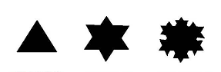
Generation of Fractals
Fractals can be generated by repeating the same shape over and over again as shown in the following figure. In figure a shows an equilateral triangle. In figure b, we can see that the triangle is repeated to create a star-like shape. In figure c, we can see that the star shape in figure b is repeated again and again to create a new shape.
We can do unlimited number of iteration to create a desired shape. In programming terms, recursion is used to create such shapes.
Zeroth Generation First Generation Second Generation

Slide 17
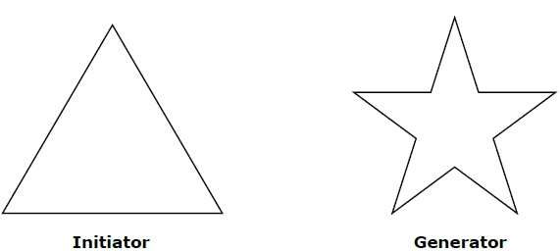
Geometric Fractals
Geometric fractals deal with shapes found in nature that have non-integer or fractal dimensions. To geometrically construct a deterministic non random self-similar fractal, we start with a given geometric shape, called the initiator. Subparts of the initiator are then replaced with a pattern, called the generator.

Slide 18
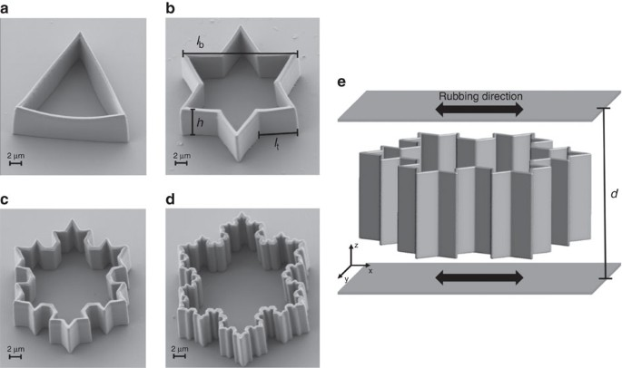
Geometric Fractals

Slide 19
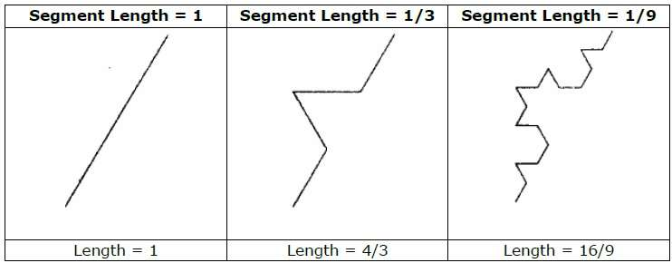
Geometric Fractals
As an example, if we use the initiator and generator shown in the above figure, we can construct good pattern by repeating it. Each straight-line segment in the initiator is replaced with four equal-length line segments at each step. The scaling factor is 1/3, so the fractal dimension is D = ln 4/ln 3 ≈ 1.2619.
Also, the length of each line segment in the initiator increases by a factor of 4/3 at each step, so that the length of the fractal curve tends to infinity as more detail is added to the curve as shown in the following figure

Slide 20

Geometric Fractals

Slide 21
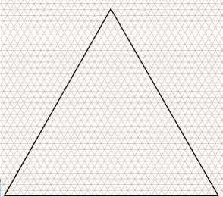
Fractals Type-1
Self Similar fractals
Geometric figure is self similar
Fractals appear identical at different scales

Slide 22
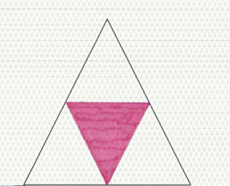
Self Similar fractals Iteration 1

Slide 23

Self Similar fractals Iteration 2

Slide 24
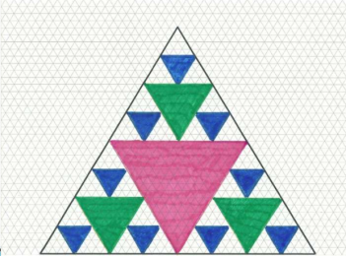
Self Similar fractals Iteration 3

Slide 25
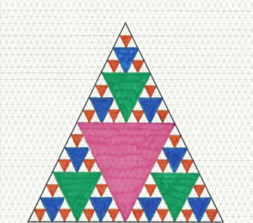
Self Similar fractals Iteration 4

Slide 26
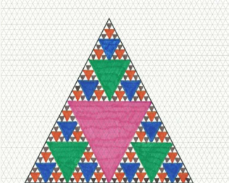
Self Similar fractals Iteration 5

Slide 27
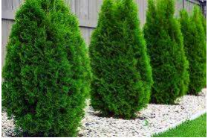


Self Similar Fractal
Self Similar Fractal Usage
Model trees, shrubs, plants

Slide 28



Fractals Type-2
Self Affine fractals
Fractal appear approximately identical at different scales
Model water, clouds, terrain

Slide 29

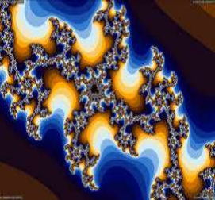
Fractals Type-3
Invariant fractals
Non linear transformation

Slide 30
Grammar based models.
Provides methods for describing the structure of plants
Use parallel graph grammar languages (called graftals!)
are languages described by a collection of productions which are all applied at once
for example, A->AA creates results of A, AA, AAAA, etc.
for example, B->A[B] creates results of B, A[B], AA[B], etc.
use [ ] for left branches and ( ) for right branches
A -> AA and B -> A[B]AA(B)

Slide 31
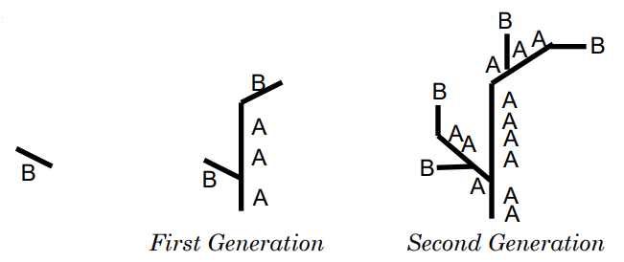
Grammar based models.
Create a 2nd generation of: AA[A[B]AA(B)]AAAA(A[B]AA(B))
use biological productions to simulate plants in development
describe the topology of plants
also describe the shape including the directions of branches and the arrangement of leaves

Slide 32
Grammar based models.
To simulate the growth of plants using graftals, languages include information on
the current age
the growth rate of each segment
the probabilities of death, dormancy, growth
the shape (depending on type and age)
the branch angles (depending on type and age)
the color and texture of each segment

Slide 33
Grammar based models.
Pseudo code simulates the growth of plants using graftals:
For (each moment in time)
For (each bud that is still alive)
Determine whether the bud dies, is dormant, or grow
If (the bud does not die)
If (the bud is not dormant)
Create a portion of a stem, determining its direction, position, color, texture; Create a new bud;

Slide 34
Particle System
The term particle system, an incredibly common and useful technique in computer graphics, was coined in the creation of this particular effect.
“A particle system is a collection of many minute particles that together represent a fuzzy object. Over a period of time, particles are generated into a system, move and change from within the system, and die from the system.”
Since the early 1980s, particle systems have been used in countless video games, animations, digital art pieces, and installations to model various irregular types of natural phenomena, such as fire, smoke, waterfalls, fog, grass, bubbles, and so on.

Slide 35
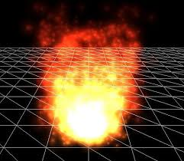
Particle System
The term particle system is loosely defined in computer graphics. It has been used to describe modeling techniques, rendering techniques, and even types of animation. In fact, the definition of a particle system seems to depend on the application that it is being used for. The criteria that hold true for all particle systems are the following:
Collection of particles
Stochastically defined attributes

Slide 36
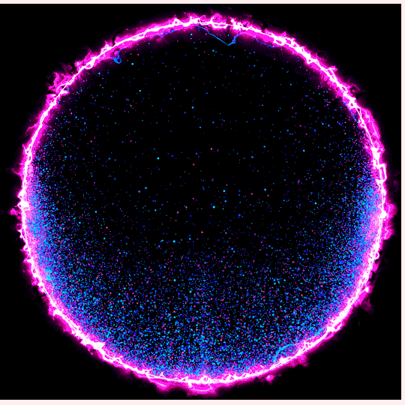
Particle System

Slide 37
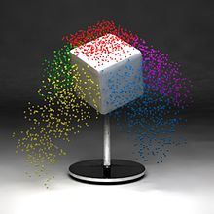
Particle System
A cube emitting 5000 animated particles, obeying a "gravitational" force in the negative Y direction.

Slide 38

Particle System
The same cube emitter rendered using static particles, or strands.

Slide 39
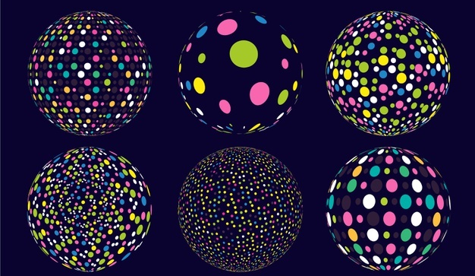
Particle System
Collection of particles -
A particle system is composed of one or more individual particles. Each of these particles has attributes that directly or indirectly effect the behavior of the particle or ultimately how and where the particle is rendered. Often, particles are graphical primitives such as points or lines, but they are not limited to this. Particle systems have also been used to represent complex group dynamics such as flocking birds.

Slide 40
Particle System
Stochastically defined attributes - The other common characteristic of all particle systems is the introduction of some type of random element. This random element can be used to control the particle attributes such as position, velocity and color. Usually the random element is controlled by some type of predefined stochastic limits, such as bounds, variance, or type of distribution.
What does stochastically mean?
Stochastic refers to a randomly determined process. The term stochastic is used in many different fields, particularly where stochastic or random processes are used to represent systems or phenomena that seem to change in a random way.

Slide 41
Particle System
Particle systems are ubiquitous in computer graphics. They’re used for modeling snow, explosions, sparks, rain, grass, and all sorts of other things that are too hard to model and animate by hand.
A particle system is simply a collection of particles, which are tiny dots that can be made to look like anything, from smoke plumes to soccer balls.
Particles are a very important tool in any CG artist’s arsenal, particularly so for animators and effects artists. They can add realism to a scene or enhance it with other-worldly effects.
If you’ve seen a big-budget movie in the past 10 years, odds are at least one explosion or dust storm in it was modeled in a 3D package and included after the scene was shot.
Particles make these effects possible and easy. Renderer Types

Slide 42
Renderer Types
Particle system renderers are divided into 2D renderers and 3D renderers. The advantage of 2D rendering over 3D rendering is that it’s much faster and certain concerns that would be prevalent in a 3D scene simply don’t exist in 2D rendering, such as 2-sided materials, mesh complexity, etc.
2D renderers are primarily implemented as engines, since their speed is more than enough for real-time applications like scientific visualization or gaming, but there are a handful of 2D particle rendering packages, with particle Illusion being the most prominent example.

Slide 43
Renderer Types
3D particle renderers are more common and you can usually find an implementation of a particle system in a package with a 3D renderer, such as Maya, 3ds max, Light wave, or Softimage.
In a 3D context, particles are used to imitate real-world phenomena that requires at least some realism (casting proper shadows or being refracted through a scene object).
This sort of thing would be rather challenging with a 2D package, even provided a capable compositing application. Thus, sometimes an artist has to make the tradeoff between the speed of use and the ease of 2D renderers and the realism and versatility of 3D renderers.

Slide 44

Renderer Types-Example

Slide 45
Emitters
Emitters give birth to particles. You’ll find the terms “birth,” “death,” and “life” to be prominent in particle jargon, since they aptly describe the logical structure of a particle animations.
Particles are born from an emitter, they are modified in some way (usually animated), they age and then die. An emitter very often specifies some important initial parameters to particles, such as their motion and their lifespan.
The various needs of a CG artist require different types of emitters for different tasks. Generally, the two types of emitters are point emitters and area emitters.

Slide 46
Emitters
Point emitters emit particles from a single point and area emitters emit particles over a specified area.
For effects like gun shots or dust trails, point emitters work best, since these types of effects represent a local reaction of an object, such as the firing of a gun or the wheel of a car against a dusty plain. However, point emitters would be quite inadequate for effects like snow storms or waterfalls. This is where area emitters come in.

Slide 47
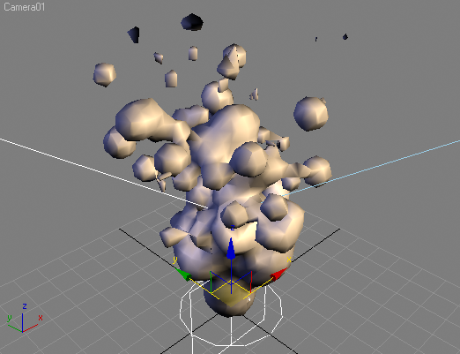
Emitters-Example

Slide 48
Emitters
An area emitter emits a particle in every partition that it covers, which is perfect for large areas required for snow storms. What would ordinarily take several point emitters and a lot of modification can easily be done with one area emitter.
There are other types of emitters, like 3ds max’s Particle Array, which emits particles from any surface, coming in handy when objects need to be exploded or when dust or other particles need to be lifted off of a surface.

Slide 49

Billboard Particles

Slide 50
Billboard Particles
Billboard particles always face the camera. That means that no matter what angle you look at the particle system, the particle’s surface is always oriented towards the viewer.
Other parameters, such as rotation, scale, and position, may affect what the surface appears like, but the orientation towards the camera always stays the same with billboard particles.
They’re one of the most common particle types where rendering speed is a concern because all they are is a rectangular polygon capable of a transparent texture.
A very large amount of billboard particles can be rendered on-screen in real time with any modern GPU.

Slide 51
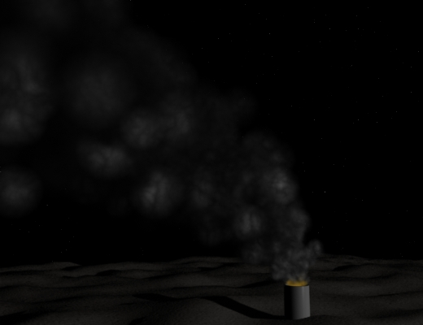
Billboard Particles

Slide 52
Billboard Particles
Billboard particles work best in situations where the “other side” of a particle is unimportant.
That is, if a user sees the effect head-on or very far away, where the camera won’t go, it’s much easier to use billboard particles and approximate depth as necessary.
Smokestacks, far-away fires, snow, rain, and some varieties of sparks are best done using billboard particles.

Slide 53
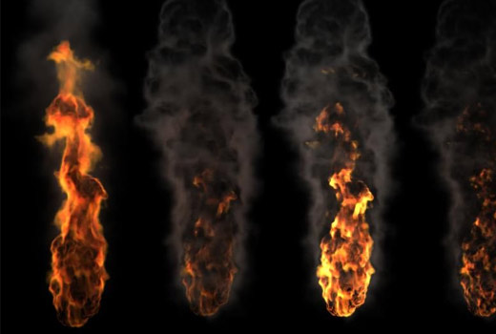
Voxels

Slide 54
Voxels
The term “voxel” is a portmanteau of “volumetric pixel.” Like pixels on the screen, where tiny dots are arranged along the vertical and horizontal dimensions, voxels are arranged along an additional third dimension.
Think of voxels as blocks stacked together, where one voxel may entirely obscure the voxel behind it.
This ability is essential in using voxels in particle systems, where transparency and occlusion between particles is important when modeling certain phenomena.

Slide 55
Voxels
Any effect that requires a high degree of realism, such as clouds, fire, or explosions can be approached with the use of voxels.
Packages like Lightwave have voxel rendering built in, but others like 3ds max can be augmented with plug-ins, such as FumeFX.
Generally, volumetric particle effects are not included by default in most 3D packages.

Slide 56

Metaballs

Slide 57
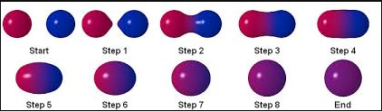
Metaballs
The theoretical concepts behind metaballs are beyond the scope of this overview, but they can be generally described as the best high-speed simulation available for liquids and similar substances, such as the “lava” inside lava lamps.
The way they work is fairly straightforward. Each particle is a round sphere, until it comes in contact with another particle.
At a certain distance apart from each other, two particles will start forming a bridge and eventually join in the shape of a larger particle.

Slide 58
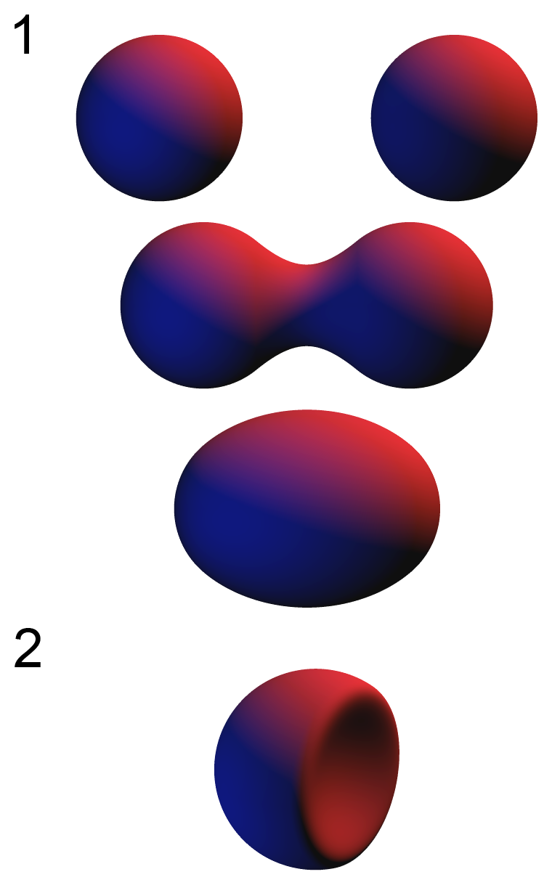
Metaballs

Slide 59

Metaballs
This effect is very common in nature, especially in the behavior of liquid drops, which makes metaballs useful in modeling fluids.
Metaballs can also be used to create 3D models of objects, especially organic objects like animals or humans, as seen below.

Slide 60
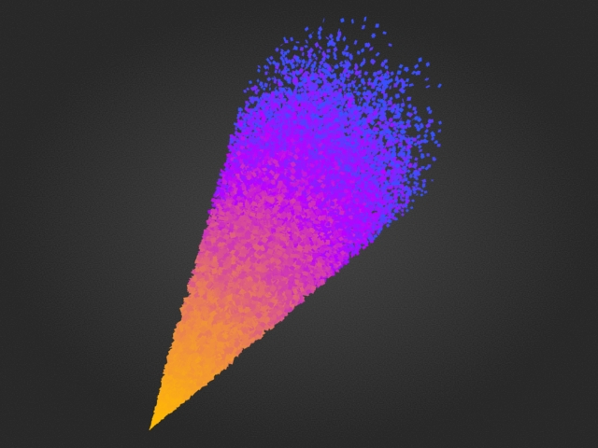
Particle Age

Slide 61
Particle Age
Particle age is an important concept because it addresses what happens to the particle’s appearance as it moves through its lifespan.
In real life, a fire has many stages: flames, soot, smoke. Sometimes the smoke is black, sometimes it’s white, sometimes it transitions from one to another due to a substance in the fire.
These changes can be modeled using particle age-dependent materials and settings.
Emitters usually provide a few age-dependent settings, such as size and speed, but they can’t change whether a particle looks like a flame or like black smoke.

Slide 62
Particle Age
That’s where using age-dependent materials comes in.
Particles can change not only color, but apparent shape, and they can even be made to look like an animation, such as a man walking.
In branding shots and Advertisements, where graphics are used for symbolism rather than realism, such versatility can come in very handy.

Slide 63

Particle Effectors

Slide 64
Particle Effectors
The particular name for these objects varies from package to package. You’ll see them called “forces” in 3ds max or “fields” in Maya.
The general idea behind effectors is that they affect the particle system somehow. Normally, the intent is to simulate real-world constraints on an otherwise ideal system.
Therefore, the standard package of effectors includes things like gravity, wind, and a suite of deflectors and attractors.
Particle effectors used in combination with proper emitter settings and proper lighting can create very convincing (or alternatively, very fantastic) effects.

Slide 65
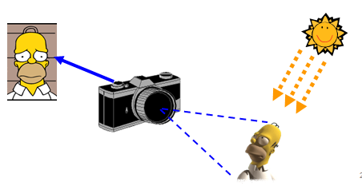
IMAGE

Slide 66
IMAGE
An image is a visual representation of something. In information technology, the term has several usages:
1) An image is a picture that has been created or copied and stored in electronic form. An image can be described in terms of vector graphics or raster graphics. An image stored in raster form is sometimes called a bitmap. An image map is a file containing information that associates different locations on a specified image with hypertext links.
Common image file formats
JPEG
GIF
GIF89a
PNG
SVG
TIFF
Disk Image

Slide 67
Common image file formats
JPEG (pronounced JAY-peg) is a graphic image file produced according to a standard from the Joint Photographic Experts Group, an ISO/IEC group of experts that develops and maintains standards for a suite of compression algorithms for computer image files. JPEGs usually have a .jpg file extension.
GIF(pronounced JIF by many, including its designer; pronounced GIF with a hard G by many others) stands for Graphics Interchange Format. The GIF uses the 2D raster data type and is encoded in binary. GIF files ordinarily have the .gif extension.

Slide 68
Common image file formats
GIF89a is an animated GIF image, formatted according to GIF Version 89a. One of the chief advantage format is the ability to create an animated image that can be played after transmitting to a viewer page that moves - for example, a twirling icon or a banner with a hand that waves or letters that magically get larger. A GIF89a can also be specified for interlaced GIF presentation.
PNG (pronounced ping ) is a Portable Network Graphics) is a file format for image compression that was designed to provide a number of improvements over the GIF format. Like a GIF, a PNG file is compressed in lossless fashion (meaning all image information is restored when the file is decompressed during viewing). Files typically have a .png extension.

Slide 69
Common image file formats
SVG is Scalable Vector Graphics, the description of an image as an application of XML. Any program such as a browser that recognizes XML can display the image using the information provided in the SVG format. Scalability means that the file can be viewed on a computer display of any size and resolution, whether the small screen of a smartphone or a large widescreen display in a PC. Files usually have .svg extension.
TIFF (Tag Image File Format) is a common format for exchanging raster graphics (bitmap) images between application programs, including those used for scanner images. A TIFF file can be identified as a file with a .tiff or ".tif" file name suffix.

Slide 70
Common image file formats
2) A disk image is a copy of the entire contents of a storage device, such as a hard drive or DVD. The disk image represents the content exactly as it is on the original storage device, including both data and structure information.
3) Another use of the term image is for a section of random access memory (RAM) that has been copied to another memory or storage location.

Slide 71
Types of an image
BINARY IMAGE– The binary image as its name suggests, contain only two pixel elements i.e 0 & 1, where 0 refers to black and 1 refers to white. This image is also known as Monochrome.
BLACK AND WHITE IMAGE– The image which consists of only black and white color is called BLACK AND WHITE IMAGE.
8 bit COLOR FORMAT– It is the most famous image format. It has 256 different shades of colors in it and commonly known as Grayscale Image. In this format, 0 stands for Black, and 255 stands for white, and 127 stands for gray.
16 bit COLOR FORMAT– It is a color image format. It has 65,536 different colors in it.It are also known as High Color Format. In this format the distribution of color is not as same as Grayscale image.

Slide 72
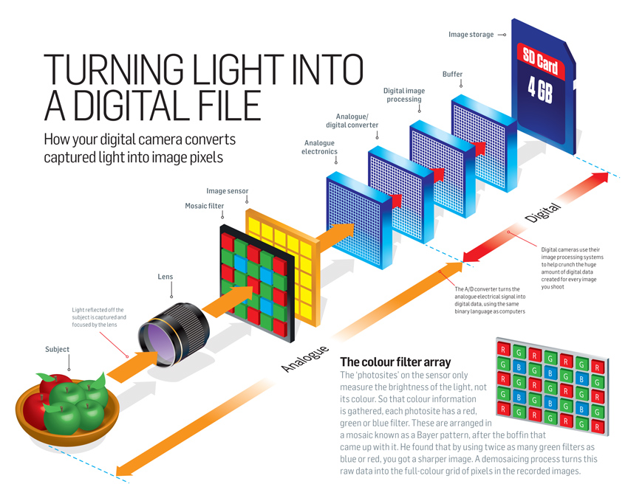

Slide 73
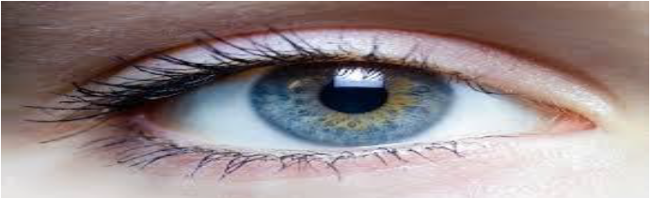

Elements of visual perception

Slide 74
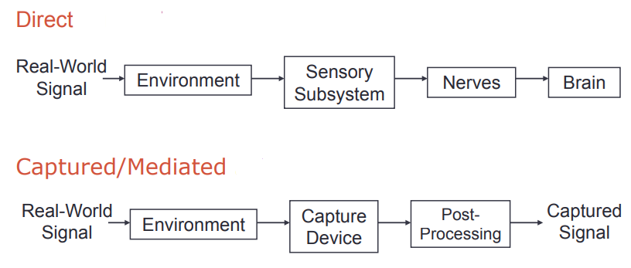
Elements of visual perception

Slide 75
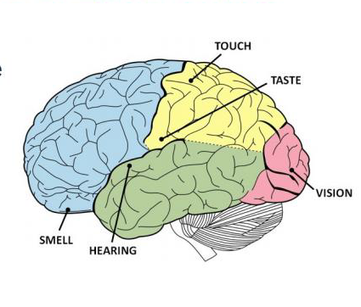
Elements of visual perception
Relative Importance of Each Sense
Percentage of neurons in brain devoted to each sense
Sight-30%
Touch-8%
Hearing-2%
Smell-<1%
Over 60% of brain involved with vision in some way

Slide 76
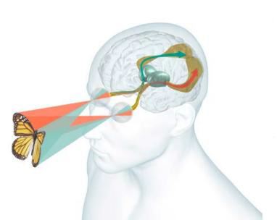
Human visual system

Slide 77
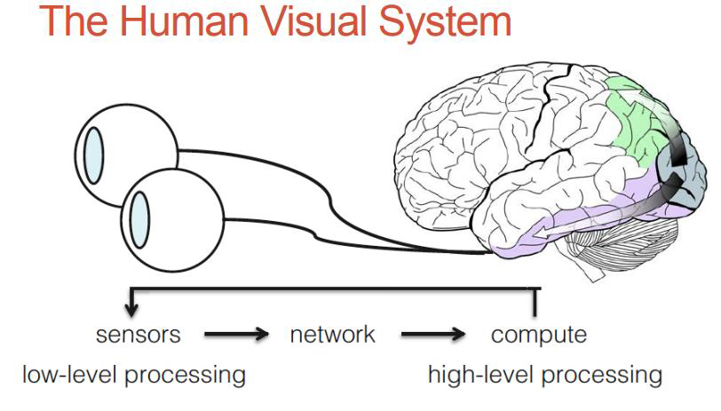
Human visual system
Sensors
Low-level Processing
Compute
High-level Processing
Network

Slide 78
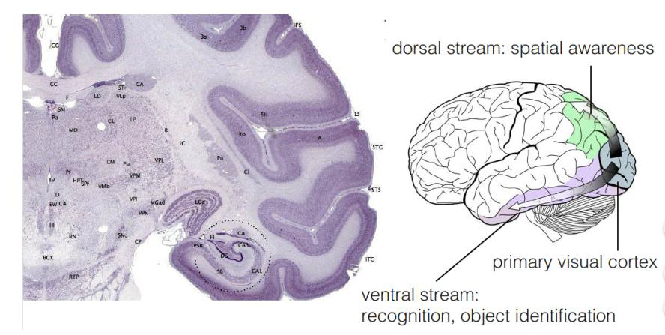
Part of Brain associated with Vision

Slide 79
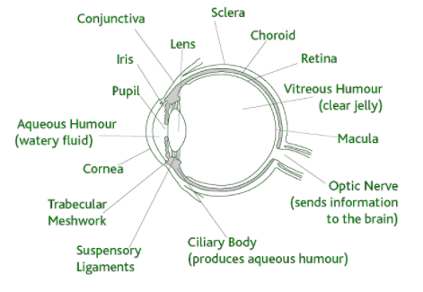
Elements of visual perception
Although the field of digital image processing is build on the foundation of mathematical and probabilistic formulations, human intuition and analysis play a central role in the choice of one technique versus another, and this choice often is made based on subjective , visual judgments. Hence developing a basic understanding of human visual perception as a first step in our journey

Slide 80
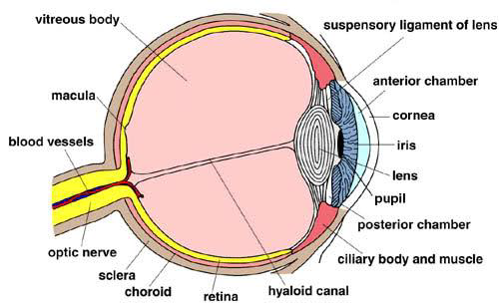
Structure of Human Eye

Slide 81
Structure of Human Eye
The eye is nearly spherical in form with an average diameter of approximately 20 mm.
It is enclosed by three membranes; the cornea and sclera outer cover, the choroid, and the retina.
The cornea is a tough, transparent tissue that covers the anterior or front surface of the eye. The sclera is continuous with the cornea.
It is the opaque membrane that encloses the remainder of the eye.

Slide 82
Elements of visual perception
The complex physical process of visualizing something involves the nearly simultaneous interaction of the eyes and the brain through a network of neurons, receptors, and other specialized cells.
The human eye is equipped with a variety of optical elements including the cornea, iris, pupil, a variable-focus lens, and the retina.
Together, these elements work to form images of the objects in a person's field of view.

Slide 83
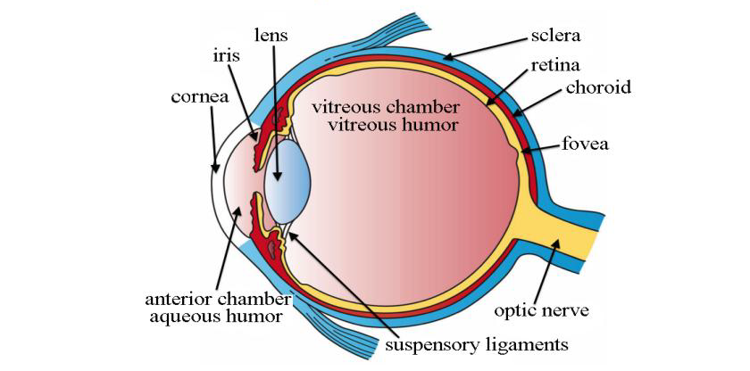
The Human Eye
Light passes through cornea and lens onto retina
Photoreceptors in retina convert light into electrochemical signals

Slide 84
Human vision
When an object is observed, it is first focused through the cornea and lens onto the retina.
Retina is a multilayered membrane that contains millions of light-sensitive cells that detect the image and translate it into a series of electrical signals.
These image capturing receptors of the retina are termed rods and cones
Cones and Rods are connected with the fibers of the optic nerve bundle through a series of specialized cells that coordinate the transmission of the electrical signals to the brain.
In the brain, the optic nerves from both eyes join at the optic chiasma where information from their retinas is correlated.

Slide 85
Human vision
The visual information is then processed through several steps, eventually arriving at the visual cortex, which is located on the lower rear section of each half of the cerebrum.
Our eyes take in light waves for our visual cortex to process into a perception.
The light passes through the cornea and is focused onto the retina with the lens.
The retina then controls the amount of light that enters the eye.
Rods and cones are used to process color in the light and dark.
Rods are responsible for processing images in a dark atmosphere.

Slide 86
Human vision
They are more sensitive and account for peripheral vision.
The cones are prominent in daylight.
The optic nerve primarily routes information to the cerebral cortex, where visual perception occurs.
A particularly specialized component of the eye is the fovea centralis, which is located on the optical axis of the eye in an area near the center of the retina.
This area exclusively contains high-density tightly packed cone cells and is the area of sharpest vision.
The density level of cone cells decreases outside of the fovea centralis and the ratio of rod cells to cone cells gradually increases.

Slide 87
Human vision
At the periphery of the retina, the total number of both types of light receptors decreases substantially, causing a dramatic loss of visual sensitivity at the retinal borders.
This is offset, however, by the fact that humans constantly scan objects in their field of view, usually resulting in a perceived image that is uniformly sharp

Slide 88
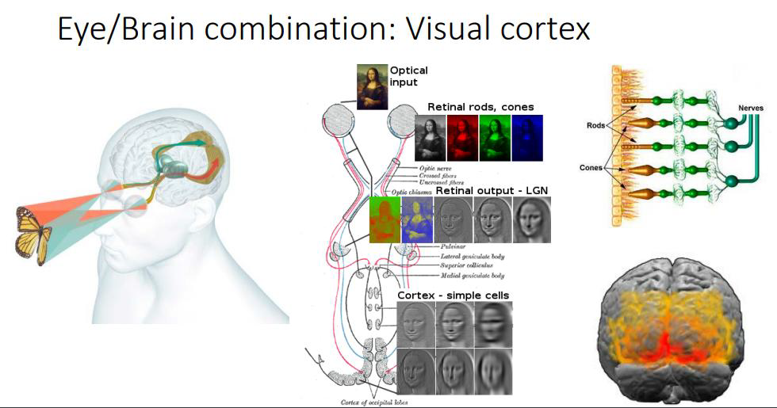
Human vision
Eye /Brain Combination: Visual Cortex

Slide 89
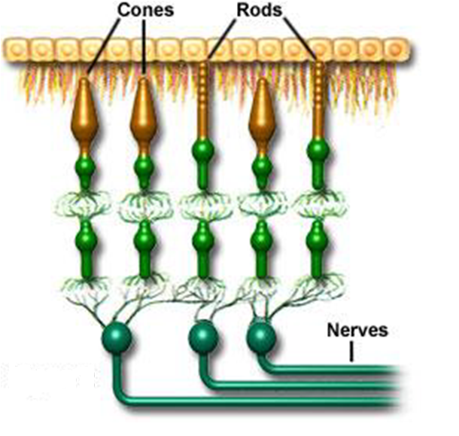
Cones and Rods

Slide 90
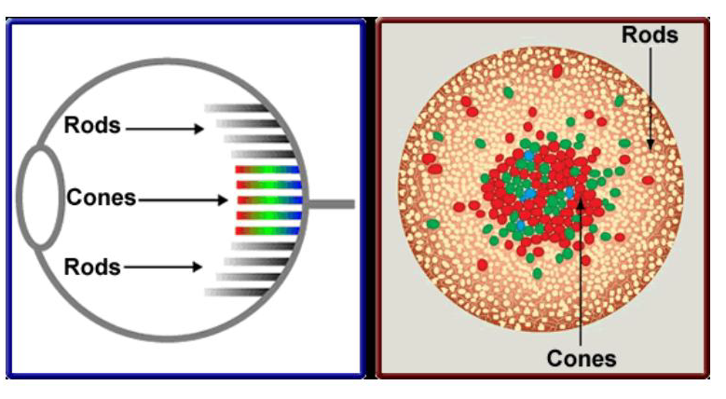
Cones and Rods
Distribution of Cones and Rods

Slide 91
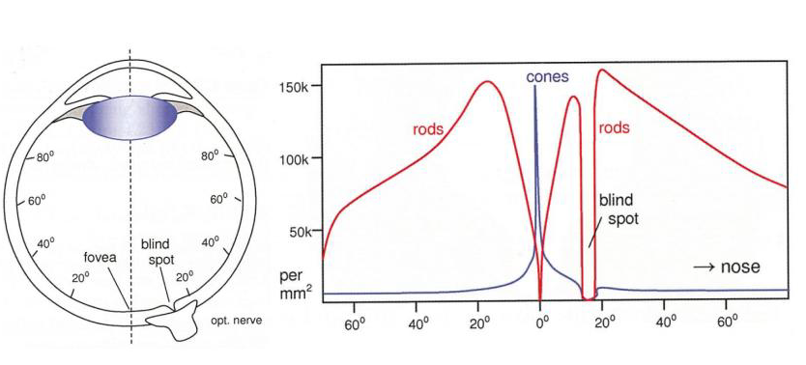
Distribution of Cones and Rods
Highest density of cones around focea
Blind spot at Optic Nerve exit point

Slide 92
Rods Vs Cones
Rods | Cones
125 million Cells in Retina | 4.5 to 6 million cells in Retina
Concentrated on periphery of retina | Responsible for color vision
No Color detection | Sensitive to red, blue, green light
Most Sensitive to light | Work best more in intense light
Scotopic (night) vision
Provide peripheral vision, motion detection

Slide 93
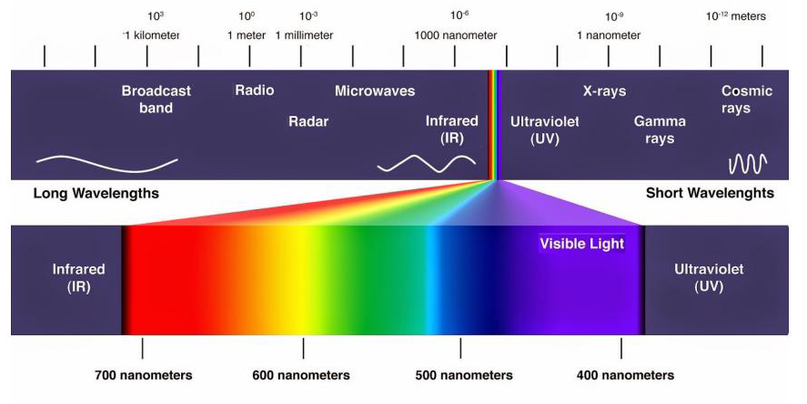
Colour Perception
Humans only perceive small part of electromagnetic spectrum

Slide 94
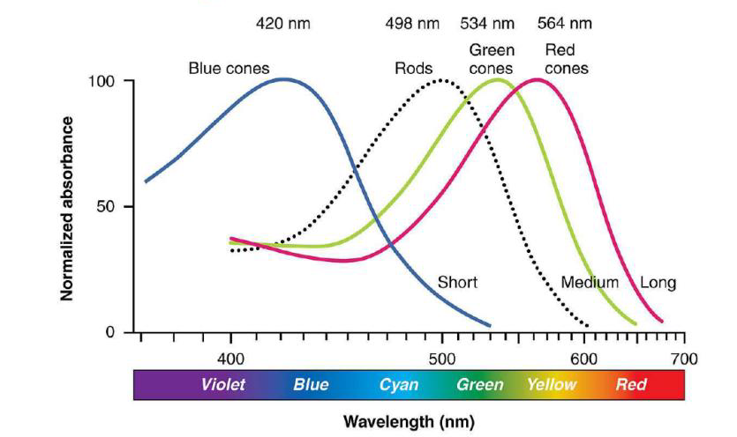
Sensitivity of Rods and Cones

Slide 95
Image Formation in the Eye
When the lens of the eye focus an image of the outside world onto a light-sensitive membrane in the back of the eye, called retina the image is formed.
The lens of the eye focuses light on the photoreceptive cells of the retina which detects the photons of light and responds by producing neural impulses.
The eye lens is (if compared to an optical lens)flexible.
It gets controlled by the fibers of the ciliary body and to focus on distant objects it gets flatter (and vice versa)

Slide 96
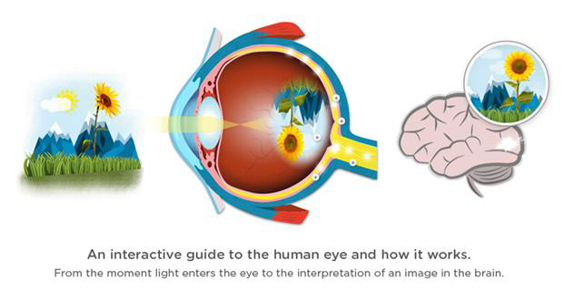
Image Formation in the Eye

Slide 97
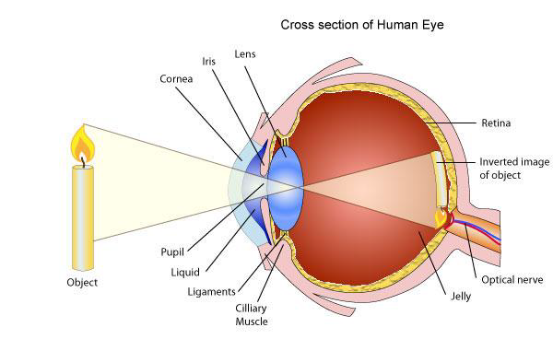
Structure of Eye

Slide 98
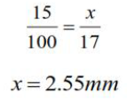
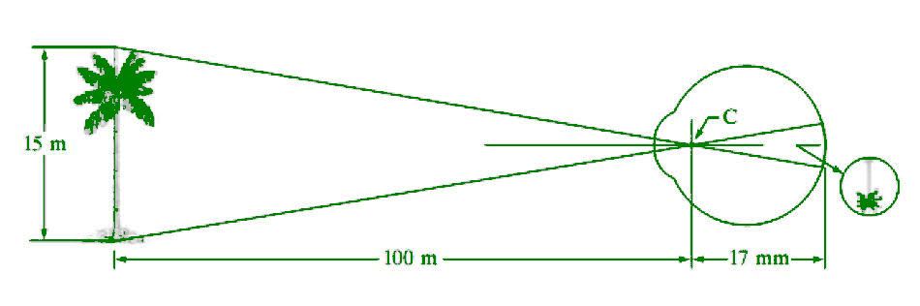
Image Formation in the Eye
Distance between the center of the lens and Retina(focal length)
Varies from 17mm to 14mm (refractive power of lens goes from minimum to maximum)
Objects farther than 3m use minimum refractive lens powers(and vice versa)

Slide 99
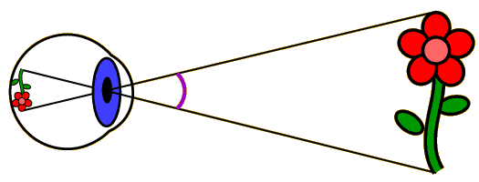
Image Formation in the Eye

Slide 100
Image Formation in the Eye
Perception takes place by the relative excitation of light receptors.
These receptors transform radiant energy into electrical impulses that are ultimately decoded by the brain
Brightness Adaptation and Discrimination:
Digital images are displayed as a discrete set of intensities.
The eyes ability to discriminate black and white at different intensity levels is an important consideration in presenting image processing result.

Slide 101
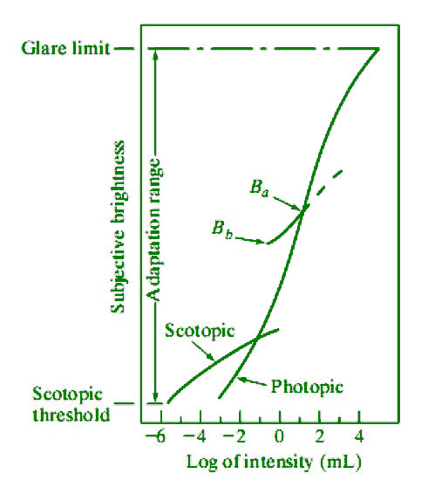
Brightness Adaptation & Discrimination:
The range of light intensity levels to which the human visual system can adapt is of the order of 10¹⁰ from the scotopic threshold to the glare limit. In a photopic vision, the range is about 10⁶.

Slide 102
Image Processing
Image processing is a method to convert an image into digital form and perform some operations on it, in order to get an enhanced image or to extract some useful information from it.
It is a type of signal dispensation in which input is an image, like video frame or photograph and output may be image or characteristics associated with that image.
Usually Image Processing system includes treating images as two dimensional signals while applying already set signal processing methods to them.

Slide 103
Purpose of Image processing
The purpose of image processing is divided into 5 groups. They are :
Visualization - Observe the objects that are not visible.
Image sharpening and restoration - To create a better image.
Image retrieval - Seek for the image of interest.
Measurement of pattern – Measures various objects in an image.
Image Recognition – Distinguish the objects in an image.

Slide 104
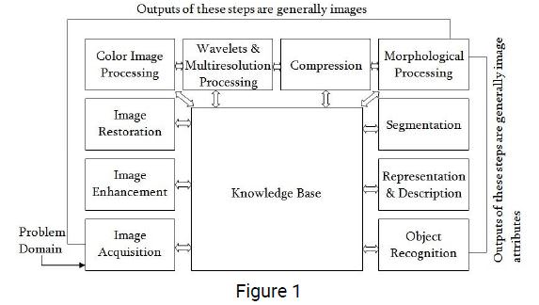
Steps in Image Processing

Slide 105
Steps in Image Processing
1. Image Acquisition
This is the first step or process of the fundamental steps of digital image processing. Image acquisition could be as simple as being given an image that is already in digital form. Generally, the image acquisition stage involves preprocessing, such as scaling etc.
2. Image Enhancement
Image enhancement is among the simplest and most appealing areas of digital image processing. Basically, the idea behind enhancement techniques is to bring out detail that is obscured, or simply to highlight certain features of interest in an image. Such as, changing brightness & contrast etc.

Slide 106
Steps in Image Processing
3. Image Restoration
Image restoration is an area that also deals with improving the appearance of an image. However, unlike enhancement, which is subjective, image restoration is objective, in the sense that restoration techniques tend to be based on mathematical or probabilistic models of image degradation.
4. Color Image Processing
Color image processing is an area that has been gaining its importance because of the significant increase in the use of digital images over the Internet. This may include color modeling and processing in a digital domain etc.

Slide 107
Steps in Image Processing
5. Wavelets and Multiresolution Processing
Wavelets are the foundation for representing images in various degrees of resolution. Images subdivision successively into smaller regions for data compression and for pyramidal representation.
6. Compression
Compression deals with techniques for reducing the storage required to save an image or the bandwidth to transmit it. Particularly in the uses of internet it is very much necessary to compress data.

Slide 108
Steps in Image Processing
7. Morphological Processing
Morphological processing deals with tools for extracting image components that are useful in the representation and description of shape.
8. Segmentation
Segmentation procedures partition an image into its constituent parts or objects. In general, autonomous segmentation is one of the most difficult tasks in digital image processing. A rugged segmentation procedure brings the process a long way toward successful solution of imaging problems that require objects to be identified individually.

Slide 109
Steps in Image Processing
9. Representation and Description
Representation and description almost always follow the output of a segmentation stage, which usually is raw pixel data, constituting either the boundary of a region or all the points in the region itself.
Choosing a representation is only part of the solution for transforming raw data into a form suitable for subsequent computer processing.
Description deals with extracting attributes that result in some quantitative information of interest or are basic for differentiating one class of objects from another.

Slide 110
Steps in Image Processing
10. Object recognition
Recognition is the process that assigns a label, such as, “vehicle” to an object based on its descriptors.
11. Knowledge Base:
Knowledge may be as simple as detailing regions of an image where the information of interest is known to be located, thus limiting the search that has to be conducted in seeking that information. The knowledge base also can be quite complex, such as an interrelated list of all major possible defects in a materials inspection problem or an image database containing high-resolution satellite images of a region in connection with change-detection applications.

Slide 111
Image Acquisition
In image processing it is defined as the action of retrieving an image from some source, usually a hardware based source for processing.
It is the first step in the workflow sequence because, without image, no processing is possible.
The image that is acquired is completely unprocessed
Now the incoming energy is transformed into a voltage by the combination of input electrical power and sensor material that is responsive to a particular type of energy being detected.
The output voltage waveform is the response of the sensors and a digital quantity is obtained from each sensor by digitizing its response

Slide 112

Image Acquisition

Slide 113

Image Acquisition
There are 3 principal sensor arrangements (produce an electrical output proportional to light intensity).
(i)Single imaging Sensor
(ii) Line sensor
(iii)Array sensor
1. Single imaging Sensor

Slide 114

Image Acquisition
(ii) Line sensor
(iii)Array sensor

Slide 115

Image Acquisition using a single sensor
Example of a single sensor is a photodiode. Now to obtain a two dimensional image using a single sensor, the motion should be in both x and y directions
Rotation provides motion in one direction
Linear motion provides motion in the perpendicular direction
Combining a single sensor with motion to generate 2D image
This is an inexpensive method and we can obtain high resolution images with high precision control. But the downside of this method is that it is slow

Slide 116
Image Acquisition using a single sensor
The most common sensor of this type is the photodiode, which is constructed of silicon materials and whose output voltage waveform is proportional to light.
The use of a filter in front of a sensor improves selectivity.
For example, a green (pass) filter in front of a light sensor favours light in the green band of the color spectrum.
As a consequence, the sensor output will be stronger for green light than for other components in the visible spectrum.

Slide 117
Image Acquisition using a single sensor
In order to generate a 2-D image using a single sensor, there have to be relative displacements in both the x- and y-directions between the sensor and the area to be imaged.
An arrangement used in high precision scanning, where a film negative is mounted onto a drum whose mechanical rotation provides displacement in one dimension.
The single sensor is mounted on a lead screw that provides motion in the perpendicular direction.
Since mechanical motion can be controlled with high precision, this method is an inexpensive (but slow) way to obtain high-resolution images.

Slide 118

Image Acquisition using a Line sensor
The sensor strips provides imaging in one direction
Motion perpendicular to the strip provides images in other direction

Slide 119
Image Acquisition using a Array sensor
In this individual sensors are arranged in the form of a 2D array. This type of arrangement is found in digital cameras eg: CCD array
In this, the response of each sensor is proportional to the integral of the light energy projected onto the surface of the sensor.
Noise reduction is achieved by letting the sensor integrate the input light signal over minutes or ever hours
Advantage
Since sensor array is 2D, a complete image can be obtained by focusing the energy pattern onto the surface of the array

Slide 120

Image Acquisition using a Array sensor
The sensor array is coincident with the focal plane, it produces an output proportional to the integral of light received at each sensor
Digital and analog circuitry sweep these outputs and convert tem to a video signal which is the digitized by another section of the imaging system. The output is a digital image

Slide 121

Image Acquisition using Sensor Strips
Fig: (a) Image acquisition using linear sensor strip (b) Image acquisition using circular sensor strip.

Slide 122
Image Acquisition using Sensor Strips
The strip provides imaging elements in one direction.
Motion perpendicular to the strip provides imaging in the other direction.
This is the type of arrangement used in most flatbed scanners. Sensing devices with 4000 or more in-line sensors are possible.
In-line sensors are used routinely in airborne imaging applications, in which the imaging system is mounted on an aircraft that flies at a constant altitude and speed over the geographical area to be imaged.
One-dimensional imaging sensor strips that respond to various bands of the electromagnetic spectrum are mounted perpendicular to the direction of flight.

Slide 123
Image Acquisition using Sensor Strips
The imaging strip gives one line of an image at a time, and the motion of the strip completes the other dimension of a two-dimensional image.
Sensor strips mounted in a ring configuration are used in medical and industrial imaging to obtain cross- sectional (“slice”) images of 3-D objects.
A rotating X-ray source provides illumination and the portion of the sensors opposite the source collect the X-ray energy that pass through the object (the sensors obviously have to be sensitive to X-ray energy).
This is the basis for medical and industrial computerized axial tomography (CAT) imaging.

Slide 124
Image Sampling and Quantization
Sampling and quantization are the two important processes used to convert continuous analog image into digital image.
Image sampling refers to discretization of spatial coordinates (along x axis) whereas quantization refers to discretization of gray level values (amplitude (along y axis)).
Given a continuous image, f(x,y), digitizing the coordinate values is called sampling and digitizing the amplitude (intensity) values is called quantization.)

Slide 125

Image Sampling and Quantization

Slide 126
Image Sampling and Quantization
The one dimensional function shown in fig (b) is a plot of amplitude (gray level) values of the continuous image along the line segment AB in fig (a).
The random variation is due to the image noise. To sample this function, we take equally spaced samples along line AB as shown in fig (c).
In order to form a digital function, the gray level values also must be converted(quantizes) into discrete quantities.
The right side of fig(c) shows the gray level scale divided into eight discrete levels, ranging from black to white.
The result of both sampling and quantization are shown in fig(d).

Slide 127
Pixels Relationship
Basic Relationships Between Pixels
1. Neighbourhood
2.Adjacency
3. Connectivity
4.Paths
5.Regions and boundaries
1. Neighborhood
Any pixel p(x, y) has two vertical and two horizontal neighbors, specified by
[(x+1, y), (x-1, y), (x, y+1), (x, y-1)]

Slide 128
1. Neighbourhood
This set of pixels are known the 4-neighbors of P, and is denoted by N4(P).
A all of them are at a unit distance from P.
The four diagonal neighbours of p(x,y) are given by, [(x+1, y+1), (x+1, y-1), (x-1, y+1), (x-1 ,y-1)]
This set is denoted by ND (P).
Each of them are at Euclidean space of 1.414 from P.
The points ND(P) and N4 (P) are together known as 8-neighbors of the point P, denoted by N8(P).
Some of the points in the N4, ND and N8may fall outside image when P lies on the border of image.

Slide 129

1. Neighbourhood
a. 4-neighbors of a pixel p are its vertical and horizontal neighbors denoted by N4(p)
b. 8-neighbors of a pixel p are its vertical horizontal and 4 diagonal neighbors denoted by N8(p)
Figure : Pixel Neighborhood: The center pixel p is shown in a dashed pattern and the pixels in the defined neighborhood are shown in filled color.

Slide 130
Adjacency
• Two pixels are connected if they are neighbors and their gray levels satisfy some specified criterion of similarity.
• For example, in a binary image two pixels are connected if they are 4-neighbors and have same value (0/1)
• Let v: a set of intensity values used to define adjacency and connectivity.
• In a binary Image v={1}, if we are referring to adjacency of pixels with value 1.
• In a Gray scale image, the idea is the same, but v typically contains more elements, for example v= {180, 181, 182,....,200}.
• If the possible intensity values 0 to 255, v set could be any subset of these 256 values.

Slide 131
Adjacency
Types of adjacency
4-adjacency: Two pixels p and q with values from v are 4-adjacent if q is in the set N4 (p).
8-adjacency: Two pixels p and q with values from v are 8-adjacent if q is in the set N8 (p).
m-adjacency (mixed): two pixels p and q with values from v are m-adjacent if:
q is in N4 (p) or
q is in ND (P) and
The set N4 (p) ∩ N4 (q) has no pixel whose values are from v (No intersection).

Slide 132


Adjacency
Mixed adjacency is a modification of 8-adjacency ''introduced to eliminate the ambiguities that often arise when 8- adjacency is used. (eliminate multiple path connection)
Pixel arrangement as shown in figure for v= {1}

Slide 133

Path
A digital path (or curve) from pixel p with coordinate (x,y) to pixel q with coordinate (s,t) is a sequence of distinct pixels with coordinates
(x0 , y0 ), (x1 , y1 ), ..., (xn , yn ), where (x0 , y0 )= (x,y), (xn , yn )= (s,t)
• (xi , yi ) is adjacent pixel (xi-1, yi-1) for 1≤j≤n ,
• n- The length of the path.
• If (x0 , y0 )= (xn , yn ):the path is closed path.
• We can define 4- ,8- , or m-paths depending on the type of adjacency specified.

Slide 134

Connectivity
Let S represent a subset of pixels in an image, Two pixels p and q are said to be connected in S if there exists a path between them.
Two image subsets S1 and S2 are adjacent if some pixel in S1 is adjacent to some pixel in S2

Slide 135

Connectivity
Region
Let R to be a subset of pixels in an image, we call a R a region of the image. If R is a connected set.
Region that are not adjacent are said to be disjoint. • Example: the two regions (of Is) in figure, are adjacent only if 8-adjacany is used.
4-path between the two regions does not exist, (so their union in not a connected set).

Slide 136

Connectivity
Boundary (border) of a region R is the set of pixels in the region that have one or more neighbors that are not in R. If R happens to be an entire image, then its boundary is defined as the set of pixels in the first and last rows and columns of the image.
Distance Measure
For pixels p,q and z, with coordinates (x,y),(s,t) and (v,w), repectively, D is a distance function if

Slide 137
Distance Measure
The distance between two pixels p and q with coordinates (x1, y1), (x2, y2) respectively can be formulated in several ways:
Pixels having a Euclidean distance r from a given pixel will lie on a circle of radius r centered at it and r = distance
D4 distance(also called City-block Distance)
In this case, the pixels having a D4 distance from (x,y) less than or equal to some value r from a diamond centered at (x,y).
For example, the pixels with D4 distance ≤2 from (x,y) (the center point) form the following contours of constant distance:

Slide 138


Distance Measure
Pixels having a city-block distance 1 from a given pixel are its 4-neighbors.
Green line is Euclidean distance. Red, blue and yellow are City Block Distance

Slide 139
Distance Measure
It's called city-block distance, because it is calculated as if on each pixel between your two coordinates stood a block (house) which you have to go around. That means, you can only go along the vertical or horizontal lines between the pixels but not diagonal. It's the same like the movement of the rook on a chess field.
Chess-board Distance=
In this case, the pixels having a D8 distance from (x,y) less than or equal to some value r from a square centered at (x,y). For example, the pixels with D8 distance ≤2 from (x,y) (the center point) form the following contours of constant distance

Slide 140


Distance Measure
To measure D8 distance, you can only go along the vertical or horizontal or diagonal lines between the pixels.
Pixels having a chess-board distance 1 from a given pixel are its 8-neighbors Dm distance between two points is defined as the shortest m path between the points.

Slide 141



Distance Measure
When V={1} p,p2 and p4 have value 1
Dm shortest distance between p and p4 is 2 When V={1} p,p1,p2 and p4 have value 1 or p,p2,p3 and p4 have value 1
Dm shortest distance between p and p4 is 3
Dm distance between p and p4 is 4

Slide 142
Problem to Solve-1
Consider the image segment shown in figure
a) determine v{0,1} and compute the lengths of the shortest 4,8 and m-paths between p&q if particular path does not exists between two points, explain why?
q
3 | 1 | 2 | 1
0 | 2 | 0 | 2
1 | 2 | 1 | 1
1 | 0 | 1 | 2
p

Slide 143

Problem to Solve-2
Consider the two image subsets, S1 and S2, shown in the following figure. For V={1}, determine whether these two subsets are (a) 4-adjacent, (b) 8-adjacent, or (c) m-adjacent.

Slide 144

Solution
Let p and q be as shown in Fig. Then,
S1 and S2 are not 4-connected because q is not in the set N4(p);
S1 and S2 are 8-connected because q is in the set N8(p);
S1 and S2 are m-connected because (i) q is in ND(p), and
(ii)the set N4(p) ∩ N4(q) is empty.

Slide 145
Solution
Measure the distance between the p & q pixels using different distance measurement technique. The coordinates of p & q are (0,0) & (3,3) respectively
a. Euclidean Distance : De (p, q) = [(x-s)2 + (y-t)2 ] 1/2
b. City Block Distance : D4 (p, q) = |x-s| + |y-t|
c. Chess Board Distance : D8 (p, q) = max(|x-s|, |y-t|)

Slide 146
REFERENCES
Alan Watt, 3D Computer graphics . Addison – Wesley 1993.
Fredrick M Weinhaus, Venkat Devarajan,Texture mapping 3D models of real-world scenes .ACM computing survey , Volume 29 1997.
James F. Blinn and Martin E. Newel,Texture and Reflection in computer generated images. ACM computing survey.
http://www.cs.csustan.edu/~rsc/CS3600F00/TextureMapping.pdf
http://www.sgi.com/grafica/texmap/index.html
http://www-2.cs.cmu.edu/~ph/texsurv.pdf

